Slide 1
Metadata Extraction of German Legal Judgments
Oliver Knapp, 27.04.19, Final Presentation

Slide 2
Key Facts
Chair: Software Engineering for Business Information Systems
Title: Metadata Extraction of German Legal Judgments
Author: Oliver Knapp
Advisor: M.Sc. Ingo Glaser (ingo.glaser@tum.de)
Supervisor: Prof. Dr. Florian Matthes (matthes@in.tum.de)

Slide 3
Outline
Motivation
Approach
Research Question
Conclusion

Slide 4
Motivation
Judgements
digitally published
no standardized (machine readable) format
Information Discovery
often done manually
time consuming
costly
knowledge-intensive
Advancement in Technology
Natural Language Processing is feasible and already widely used for similar tasks
Keyword detection
Analysis
Information retrieval
200427 Knapp BA Final

Slide 5
Approach
Corpus
Source | XML | Plain text | Nr of documents | Usage
Otto-Schmidt MDR | ✓ | X | 7203 | Model training: Metadata
Otto-Schmidt Rechtsprechung | ✓ | X | 66011 | Model training: Metadata, Segmentation Structure
Gesetze-Bayern | ✓ | X | 31656 | Metadata
BGH | X | ✓ | 7196 | Structure of plain text judgments
Juris/Justiz.de | X | X | ? | X

Slide 6
Rule-based Approaches vs. Machine Learning
 | Pro | Con
Rule-based | Declarative Easy to comprehend Easy to maintain Easy to incorporate domain knowledge Easy to trace and fix the cause of errors | Heuristic Requires tedious manual labor
ML | Trainable Adaptable Reduces manual effort | Requires labeled data Requires retraining for domain adaption Requires ML expertise to use or maintain Opaque

Slide 7
Rule-based Approaches vs. Machine Learning
German Code of Civil Procedure (§313 ZPO) and
Code of Criminal Procedure (§267 StPO)
regulate the content and structure of German judgments
 | Pro | Con
Rule-based | Declarative Easy to comprehend Easy to maintain Easy to incorporate domain knowledge Easy to trace and fix the cause of errors | Heuristic Requires tedious manual labor
ML | Trainable Adaptable Reduces manual effort | Requires labeled data Requires retraining for domain adaption Requires ML expertise to use or maintain Opaque

Slide 8
Rule-based Approaches vs. Machine Learning
 | Pro | Con
Rule-based | Declarative Easy to comprehend Easy to maintain Easy to incorporate domain knowledge Easy to trace and fix the cause of errors | Heuristic Requires tedious manual labor
ML | Trainable Adaptable Reduces manual effort | Requires labeled data Requires retraining for domain adaption Requires ML expertise to use or maintain Opaque
Publishers provide labeled judgments

Slide 9
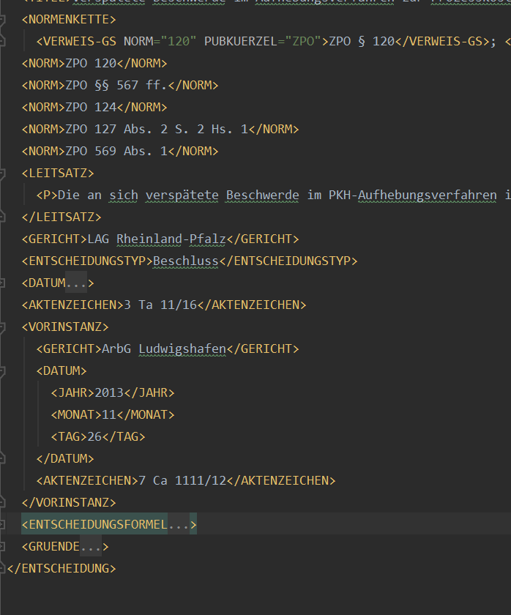
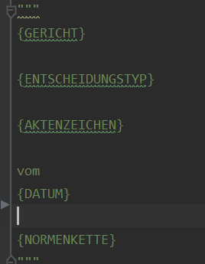
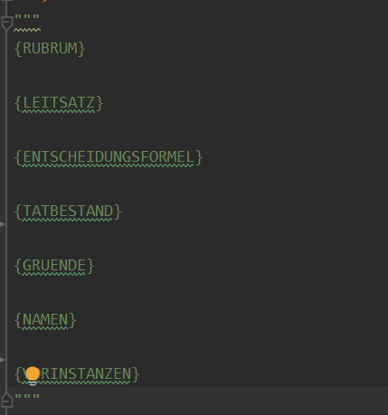
XML Otto Schmidt -> Plain text judgment
Template: Rubrum
Template: Judgment

Slide 10
Research Questions
What is the structure of German legal judgment?
How can manually processed judgments be used for performance evaluation and machine learning?
What metadata should be extracted?
Evaluation: How good does it perform?

Slide 11
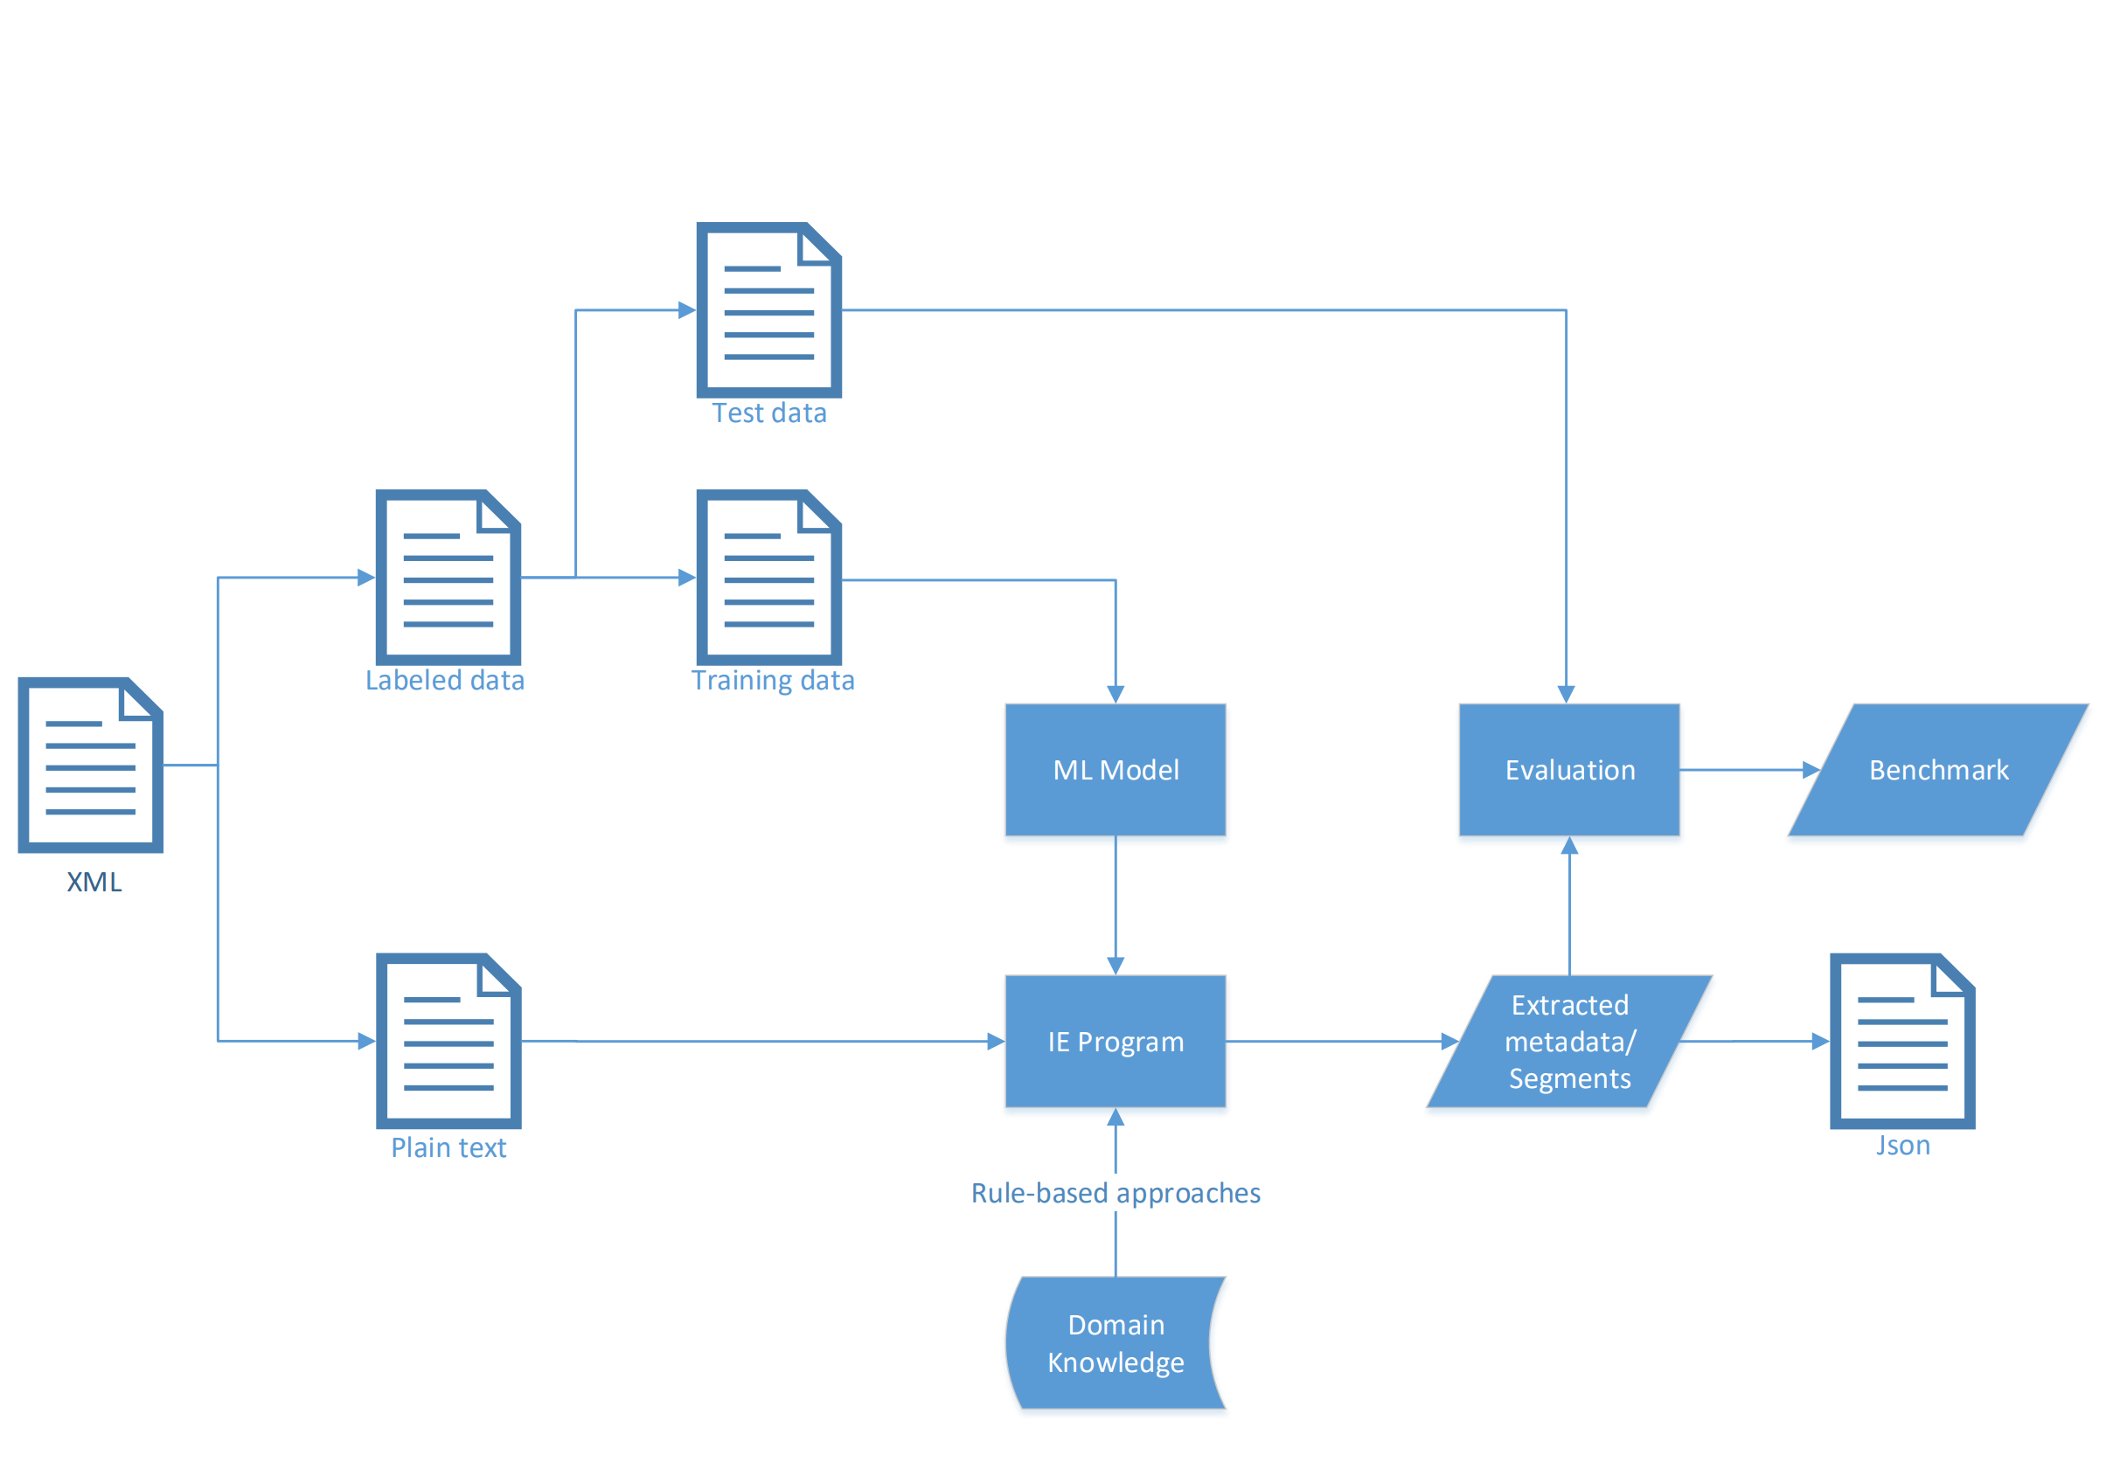
Approach

Slide 12
What metadata should be extracted?
Reference Number
Date
Court
Type
Applied Laws
References to laws/judgments
Segments
Rubrum

Slide 13

Metadata in rubrum
Court
Type of decision
Reference number /
Aktenzeichen
Date
Applied Laws /
Normenkette

Slide 14
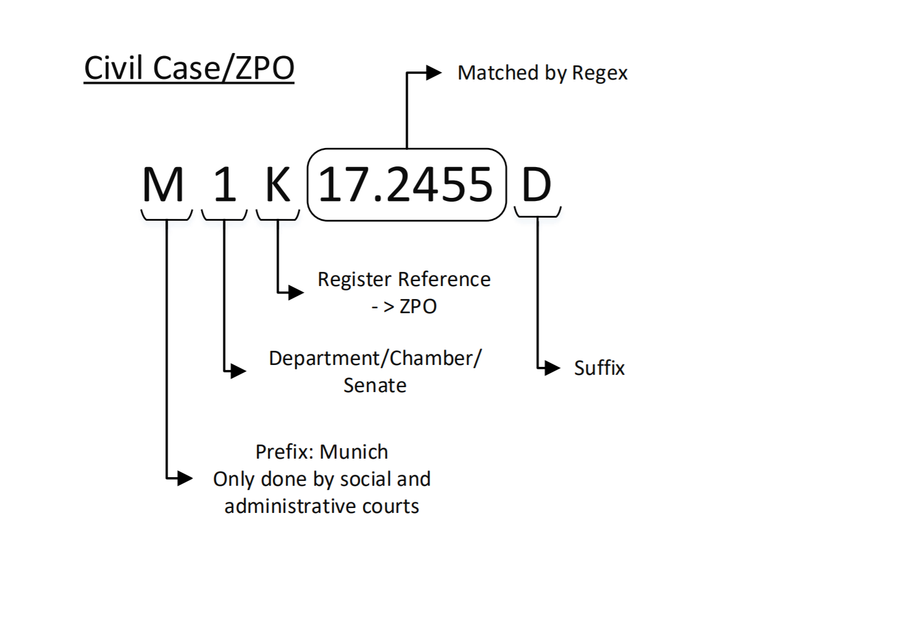
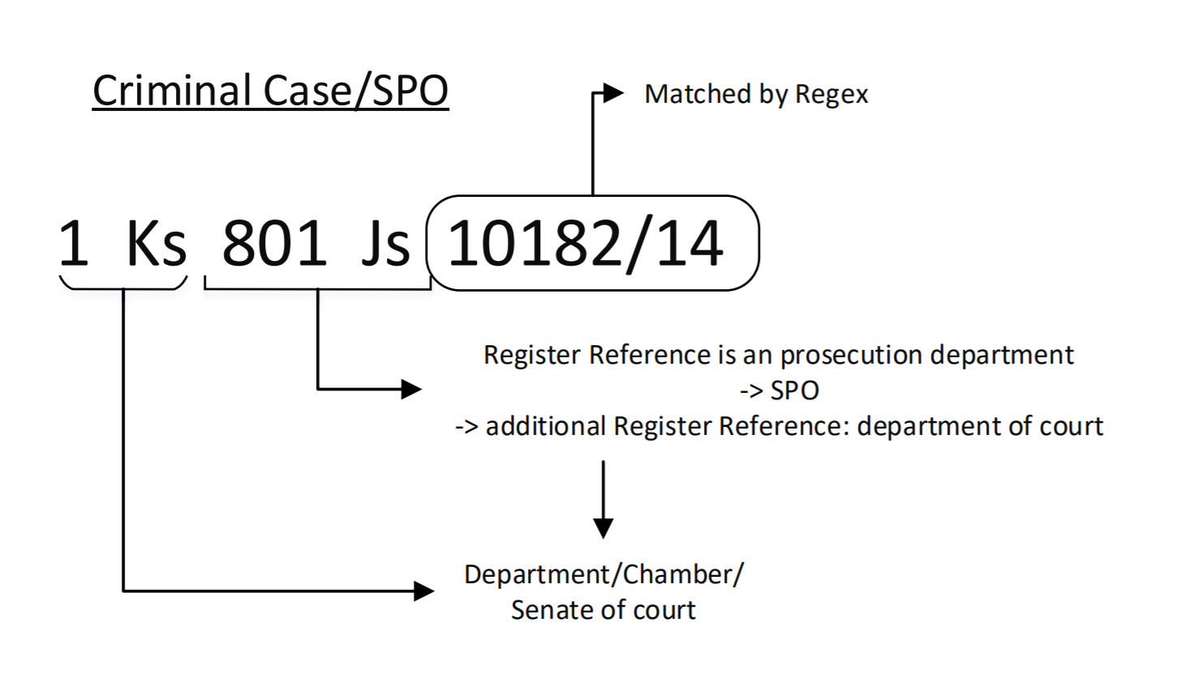
The importance of the reference number
Civil Case
Criminal Case
(space)<Reference Year>.<Consecutive Number>
(space)<Consecutive Number>/<Reference Year>

Slide 15
What is the structure of German legal judgment?

Slide 16
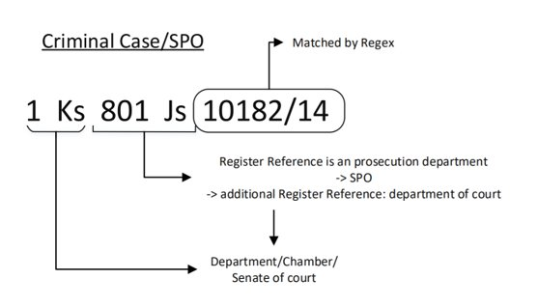
What is the structure of German legal judgment?

Slide 17
Reference Number / Aktenzeichen
Pick the first match in document
- Register references, Suffixes and Prefixes from lookup table
Evaluation:
Works well on generated judgments
~100% detection rate
~ 91% completely parsed
Problems:
Unknown Suffixes/Prefixes
Erratic editorial Processing
Z3-3-3194-1-53-11/17
3 - 10 O 173/14

Slide 18
What metadata should be extracted?
Reference Number
Date
Court
Type
Applied Laws
References to laws/judgments
Segments
Rubrum

Slide 19
Date
Pick first date in document
Regex vs. dateparser library vs. SpaCy pos-tagging
Dateparser library to greedy/low precision:
- useful for colloquial texts (social media)
Legal judgments are written by professionals:
- irregular formats unlikely
26. 7. 2011
11. November 2019
26.7.2011
11.November 2019
=> Regex

Slide 20
What metadata should be extracted?
Reference Number
Date
Court
Type
Applied Laws
References to laws/judgments
Segments
Rubrum

Slide 21
Court
- finite number of courts
=> lookup
- pick first occurence
Issues:
Court names not standardized
-> Aliases
"Saarländisches Oberlandesgericht": [
"Oberlandesgericht Saarländisches",
"Oberlandesgericht Saarbrücken",
"Saarländisches Oberlandesgericht"
],

Slide 22
What metadata should be extracted?
Reference Number
Date
Court
Type
Applied Laws
References to laws/judgments
Segments
Rubrum

Slide 23
Type
'Beschluss',
'Urteil',
'Endurteil',
'Teilurteil',
'Gerichtsbescheid'
- finite number of types
=> lookup
Pick first occurence

Slide 24
What metadata should be extracted?
Reference Number
Date
Court
Type
Applied Laws
References to laws/judgments
Segments
Rubrum

Slide 25
Applied Laws / Normenkette
- added afterwards
- contains the most decisive laws for the judgment
Reference detection
- Reference detection trained on positional information
Other trained model
- works well
- improve with domain knowledge
Rule-based
- ratio of the number of numeric tokens in a line
to the number of abbreviation of laws and
associated abbreviation(like ’Art‘ or ’Abs‘)
- weights the line depending on the position in the rubrum
GG Art. 9 Abs. 3 S. 1,GG Art. und S. 2,EMRK Art. 11
Tarifvertrag zur Anpassung des Tarifrechts Manteltarifliche Vorschriften(BAT-O) vom 10. Dezember 1990 §1; Bundes-Angestelltentarifvertrag vom23. Februar 1961 §46; Tarifvertrag über die Versorgung der Arbeitnehmer desBundes und der Länder sowie von Arbeitnehmern kommunaler Verwaltungenund Betriebe (Versorgungs-TV) vom 4. November 1966 §5 Abs. 1 Buchst. b;

Slide 26
What metadata should be extracted?
Reference Number
Date
Court
Type
Applied Laws
References to laws/judgments
Segments
Rubrum

Slide 27
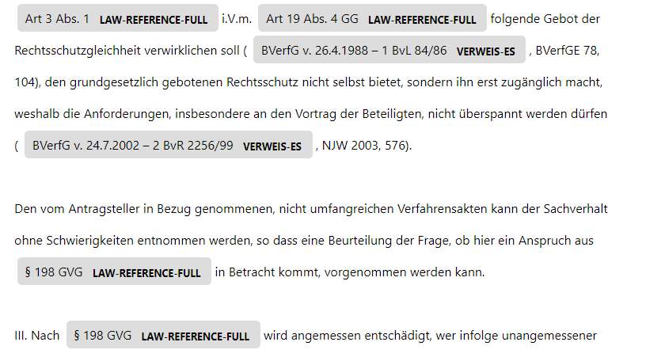
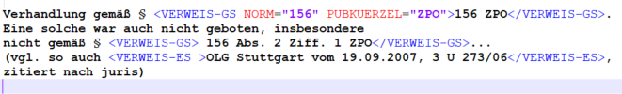
Named Entity Recognition: References
 | Reference to law | Reference to judgment | Total
Precision | 94.8 | 92.8 | 94.2
Recall | 98.0 | 98.4 | 98.2
F1-Score | 96.4 | 95.5 | 96.0

Slide 28
What metadata should be extracted?
Reference Number
Date
Court
Type
Applied Laws
References to laws/judgments
Segments
Rubrum

Slide 29
Previous Instances
Done by Segmentation

Slide 30
Segmentation
Rubrum
Decision/Tenor/Entscheidungsformel
Facts/Tatbestand
Reasoning/Gründe
Previous Instances
Reference Number
Date
Court
Decision Type
Applied Laws

Slide 31
Segmentation
Rubrum
Decision/Tenor/Entscheidungsformel
Facts/Tatbestand
Reasoning/Gründe
Previous Instances
Merged in judgments under Criminal Code (SPO)
Use different classifiers after distinction between criminal and civil code by reference number parsing
Classifier could for Civil Code could be used to distinct between facts and reasoning also for Criminal Code judgments

Slide 32
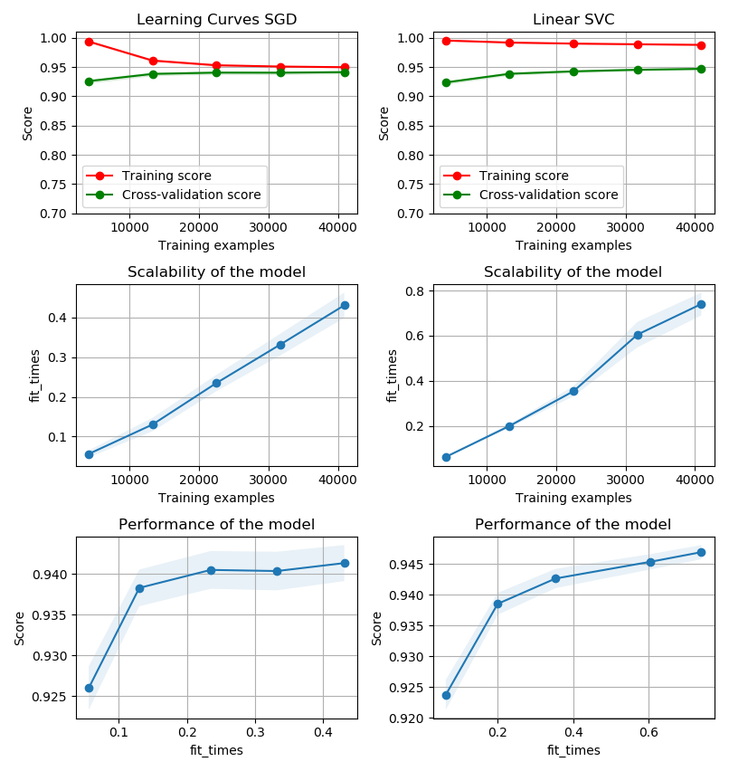
Segmentation
Feature Extraction:
Count Vectorizer + TF-IDF
Removing stopwords decreased performance
-> different style of language between segments
-> decision: simple statement
-> reasoning: complex sentence
-> conjunctions as "glue" of longer sentences
Linear Support Vector Classifier
- multiclass support: one vs the rest
- scales well with large number of samples
other algorithms like MLPC cannot use
the high number of samples fit times are to high

Slide 33
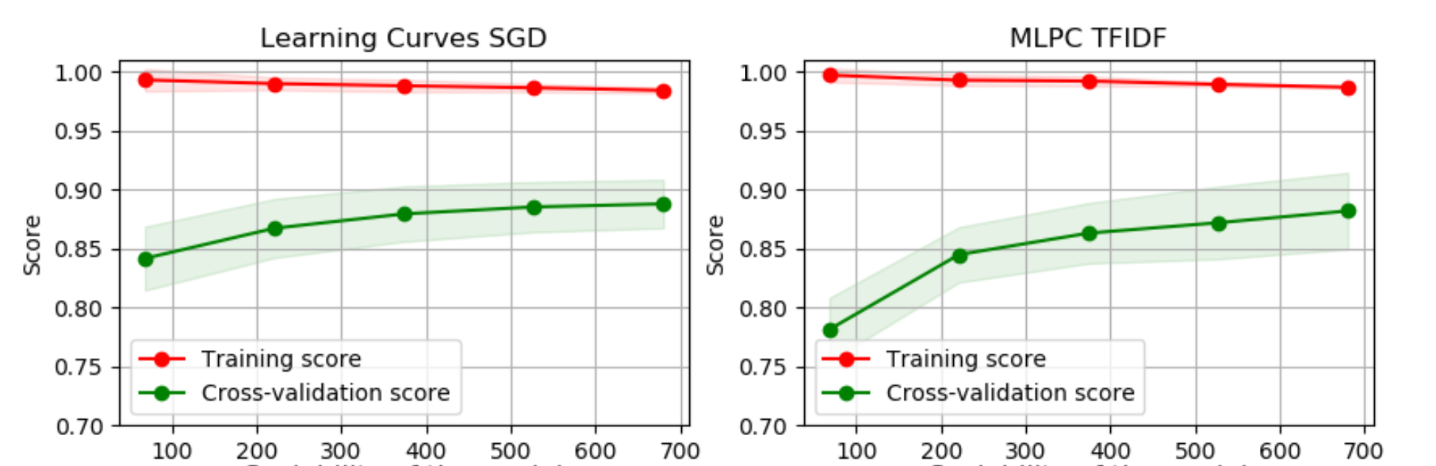
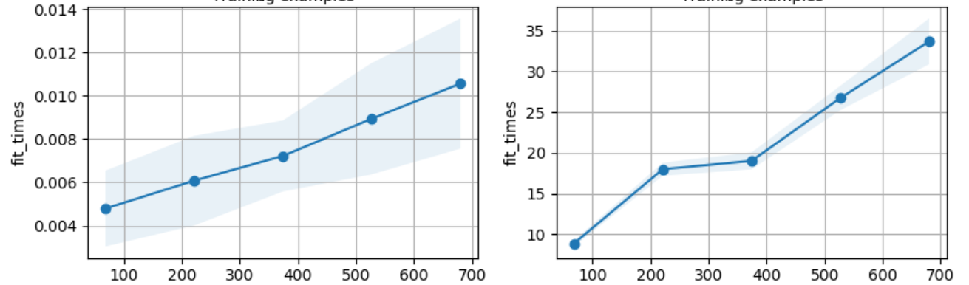
Segmentation
Number of samples
Number of samples
Comparison training statitistics SGD Classifier <-> MLPC

Slide 34
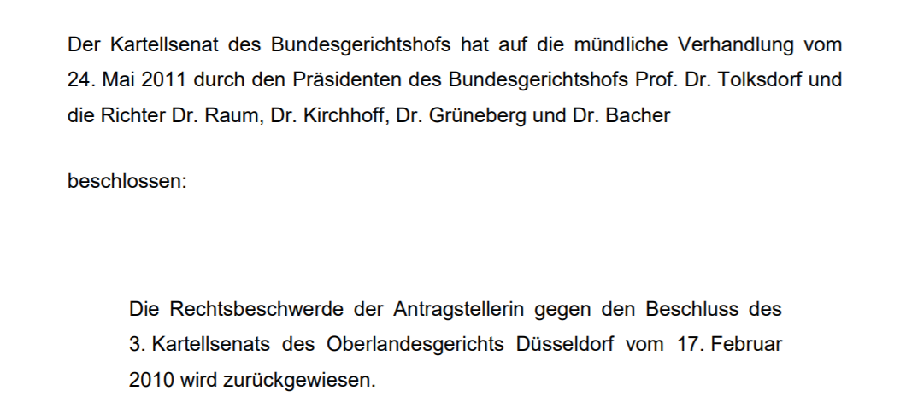
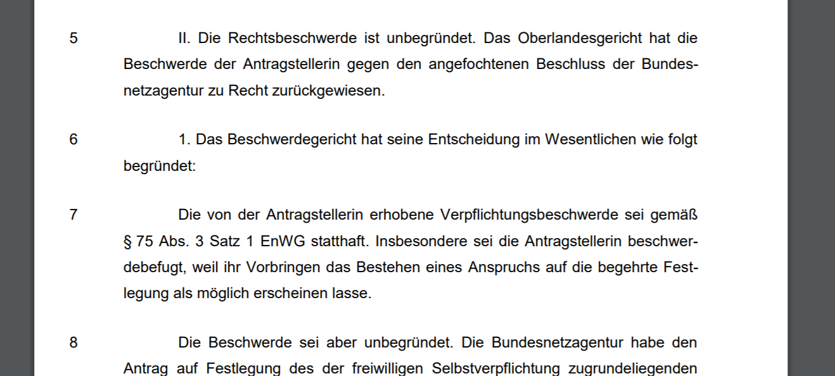
Segmentation
Constraint:
Training data was split into paragraphs
=> Plain text input data must be preprocessed
by Sentence Boundary Detection
or
Use of structural information like double line breaks etc
Paragraphs from segment 'Decision'
Paragraphs from segment Reason
Source: BGH, EnVR 27/10, 24.5.2011

Slide 35
Segmentation
Linear Support Vector Classifier classifying paragraphs of a judgment under ZPO, when rubrum is split by lines
 | Precision | Recall | F1-Score | Support
Reference Number | 0.88 | 0.80 | 0.84 | 2703
Court | 0.96 | 0.99 | 0.97 | 2703
Type of Decision | 0.75 | 1.00 | 0.86 | 2703
Date | 0.92 | 0.99 | 0.96 | 2703
Applied Laws | 0.97 | 0.96 | 0.97 | 2375
Guiding Principle | 0.74 | 0.40 | 0.62 | 5232
Decision | 0.95 | 0.82 | 0.88 | 12867
Facts | 0.86 | 0.92 | 0.89 | 64914
Reasoning | 0.90 | 0.88 | 0.89 | 74646
Previous Instance | 0.99 | 1.00 | 1.00 | 2499
Rubrum
Body Segments
Notice the class ’Facts‘ (Tatbestand) which only exists as an independently labeled segment under ZPO

Slide 36
Segmentation
Linear Support Vector Classifier classifying paragraphs of a judgment under ZPO, when rubrum is split by lines
 | Precision | Recall | F1-Score | Support
Reference Number | 0.88 | 0.80 | 0.84 | 2703
Court | 0.96 | 0.99 | 0.97 | 2703
Type of Decision | 0.75 | 1.00 | 0.86 | 2703
Date | 0.92 | 0.99 | 0.96 | 2703
Applied Laws | 0.97 | 0.96 | 0.97 | 2375
Guiding Principle | 0.74 | 0.40 | 0.62 | 5232
Decision | 0.95 | 0.82 | 0.88 | 12867
Facts | 0.86 | 0.92 | 0.89 | 64914
Reasoning | 0.90 | 0.88 | 0.89 | 74646
Previous Instance | 0.99 | 1.00 | 1.00 | 2499
Very limited possibilities: Urteil/Entscheidung
Rubrum
Body Segments
Notice the class ’Facts‘ (Tatbestand) which only exists as an independently labeled segment under ZPO

Slide 37
Segmentation
Linear Support Vector Classifier classifying paragraphs of a judgment under ZPO, when rubrum is split by lines
 | Precision | Recall | F1-Score | Support
Reference Number | 0.88 | 0.80 | 0.84 | 2703
Court | 0.96 | 0.99 | 0.97 | 2703
Type of Decision | 0.75 | 1.00 | 0.86 | 2703
Date | 0.92 | 0.99 | 0.96 | 2703
Applied Laws | 0.97 | 0.96 | 0.97 | 2375
Guiding Principle | 0.74 | 0.40 | 0.62 | 5232
Decision | 0.95 | 0.82 | 0.88 | 12867
Facts | 0.86 | 0.92 | 0.89 | 64914
Reasoning | 0.90 | 0.88 | 0.89 | 74646
Previous Instance | 0.99 | 1.00 | 1.00 | 2499
Rubrum
Editorial information, added afterwards. Often confused with Reasoning and Decision
Body Segments
Notice the class ’Facts‘ (Tatbestand) which only exists as an independently labeled segment under ZPO

Slide 38
Segmentation
Linear Support Vector Classifier classifying paragraphs of a judgment under ZPO, when rubrum is split by lines
 | Precision | Recall | F1-Score | Support
Reference Number | 0.88 | 0.80 | 0.84 | 2703
Court | 0.96 | 0.99 | 0.97 | 2703
Type of Decision | 0.75 | 1.00 | 0.86 | 2703
Date | 0.92 | 0.99 | 0.96 | 2703
Applied Laws | 0.97 | 0.96 | 0.97 | 2375
Guiding Principle | 0.74 | 0.40 | 0.62 | 5232
Decision | 0.95 | 0.82 | 0.88 | 12867
Facts | 0.86 | 0.92 | 0.89 | 64914
Reasoning | 0.90 | 0.88 | 0.89 | 74646
Previous Instance | 0.99 | 1.00 | 1.00 | 2499
Rubrum
Very distinct format:
<Court>, Entscheidung vom <Date> - <Reference number> -
OLG Stuttgart, Entscheidung vom 30.01.2012 - 5 U 128/11 -
Body Segments
Notice the class ’Facts‘ (Tatbestand) which only exists as an independently labeled segment under ZPO

Slide 39
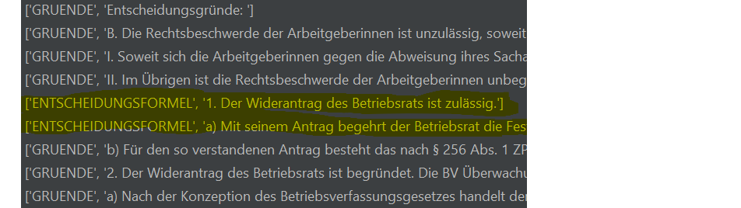
Applying Domain Knowledge to Segmentation
- Classifier predicts label for paragraphs
Domain Knowledge: Specific order of segments
-> relabel out-of-order labeled paragraphs

Slide 40
Summary
Extracting metadata can be done automatically
Rule-based approaches and ML approaches both are promising
Judgments are steadily structured documents.
- Implementation can rely on constraints:
=> defined positions
=> fixed sequences
Implementation relies on OCR and Sentence Boundary Detection

Slide 41
Future Work and Outlook
Improve classifier
- Gather more training data
- Labeling by domain expert
Connect to knowledge database
- complete lookups for courts, register references
- network via references
=> recommender system
=> data mining
Finer granularity of segmentation
- separate facts from reasoning in criminal code judgments
Make use of defined data format
- Akoma Ntoso legalXML
- courts provide documents in this format

Slide 42
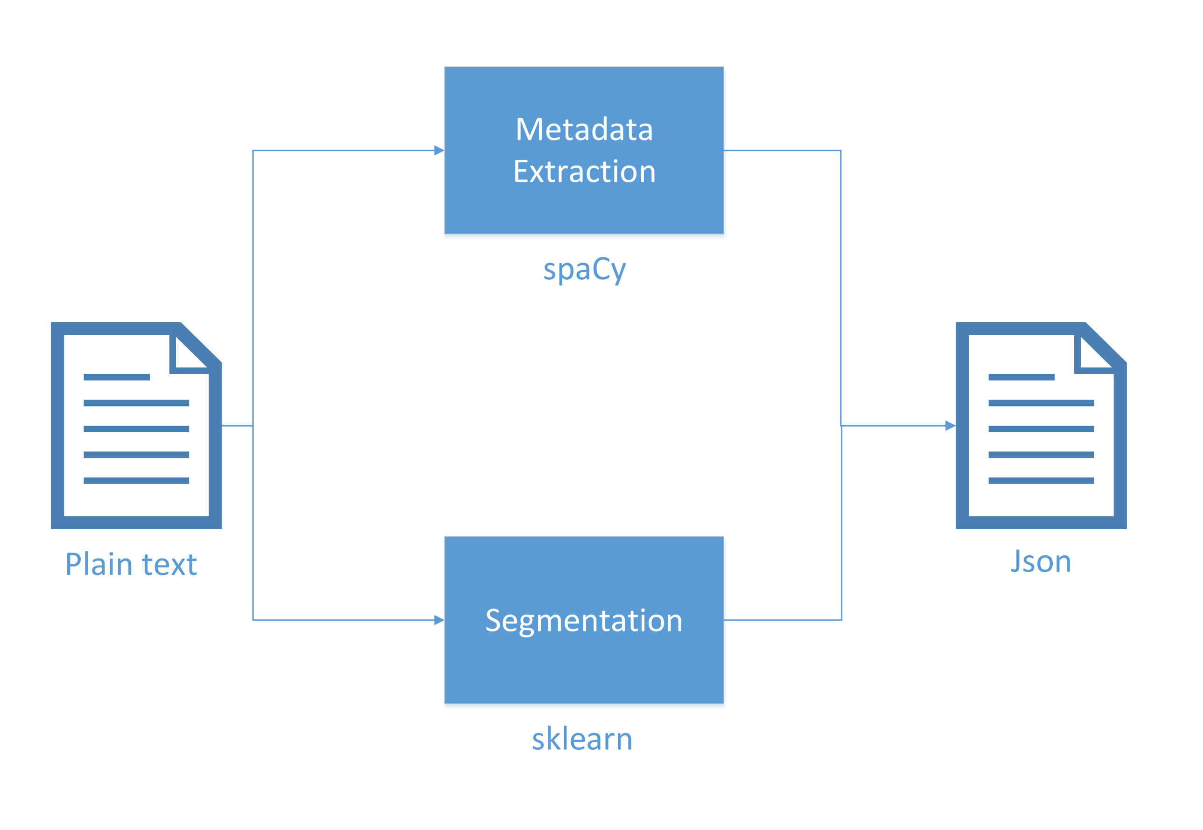

Slide 43
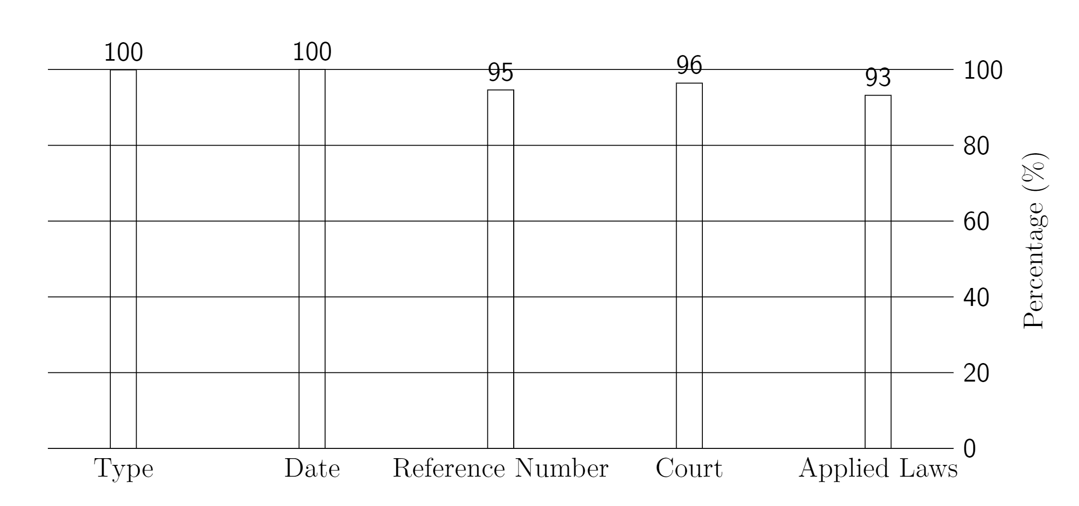

Slide 44

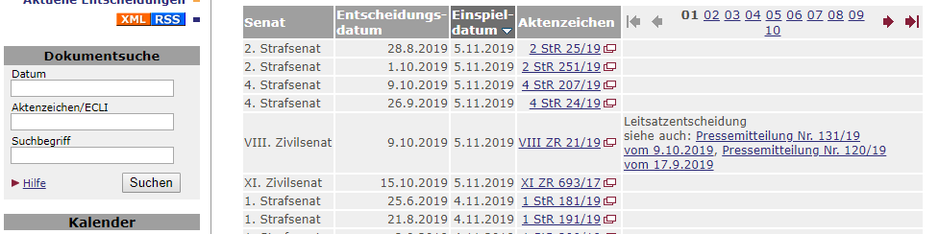
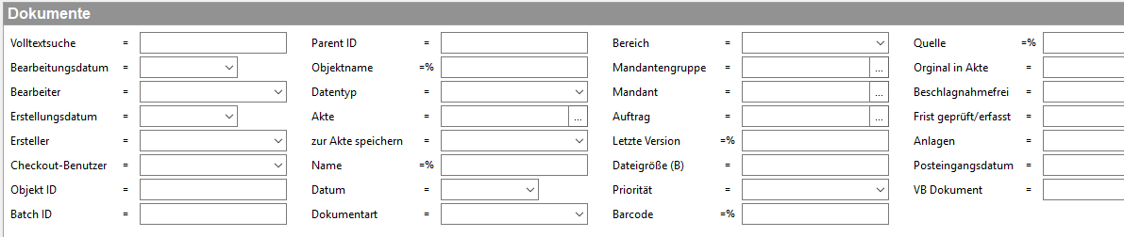
Problem Statement: Current Situation
Search mask of modern content management system vs platform for Judgments
http://juris.bundesgerichtshof.de/cgi-bin/rechtsprechung/list.py?Gericht=bgh&Art=en&Datum=Aktuell&Sort=12288
https://www.juris.de/jportal/portal/t/15vb/page/homerl.psml/js_pane/Suchportlet2

Slide 45
Artifacts
Code
Input:
Judgements (as Fulltext or XML)
Output:
Metadata in without strong format (JSON) of respective Judgement
Written Bachelor Thesis
judgement
Implementation
metadata

Slide 46
Schedule
 | October | November | December | January | February
Literature Research
Implementation
Model Training
Evaluation
Writing
Review

Slide 47
Oliver Knapp
17132
matthes@in.tum.de

Slide 48
Stick to the good sebis traditions
  Provide action links at the bottom of the slide to guide the audience to our web pages or publications (see below). (Select the text, press CTRL-K)
  Use a file name according to our sebis conventions which helps us and our audience to find the file of your presentation on our web site with Google search:
    YYMMDD Author Short Title
    Include this string in the footer (Einfügen -> Kopf- und Fusszeile -> Fusszeile)
    The unusual date format simplifies the search for the latest version of a slide in an alphabetical directory listing (Dropbox, Explorer, Tricia, Sky-Drive)
[Ha13g]Hauder, M., Roth, S., Matthes, F.: Current Tool support for Metrics in Enterprise Architecture Management
For more information visit BEAMS , EAM Pattern Catalog and EAM KPI Catalog (http://wwwmatthes.in.tum.de)

Slide 49
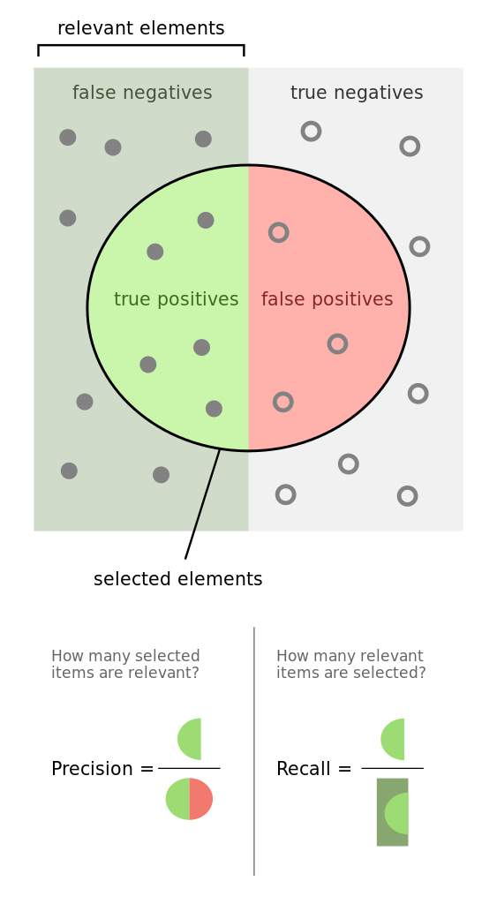
Performance Measures
Precision = TP / (TP + FP)
Recall = TP / (TP + FN)
https://en.wikipedia.org/wiki/File:Precisionrecall.svg

Slide 50
Use the sebis visual language
(shapes, fonts, colors, sizes)
Default
Line Style
Default Rectangle
Default
Rounded R.
Text
Default
Text
User
Store
Information
Arrow
Cloud
Process
Box
Explanation
Fast
Form 1
Fast
Form 2
Fast
Form 3
Fast
Form 4
Fast
Form 5
Fast
Form 6
Fast
Form 6
Fast
Form 1
Fast
Form 2
Fast
Form 3
Fast
Form 4
Fast
Form 5
Fast
Form 6
Fast
Form 6

